Slide 1
RAPID APPLICATION DEVELOPMENT
PRESENTED BY,
RAMYA S

Slide 2
RAPID APPLICATION DEVELOPMENT(RAD)
Rapid Application Development (RAD) is a software development methodology that focuses on building applications in a very short amount of time
It is a high speed adaptation of the linear sequential model in which rapid development is achieved by using component based construction.

Slide 3
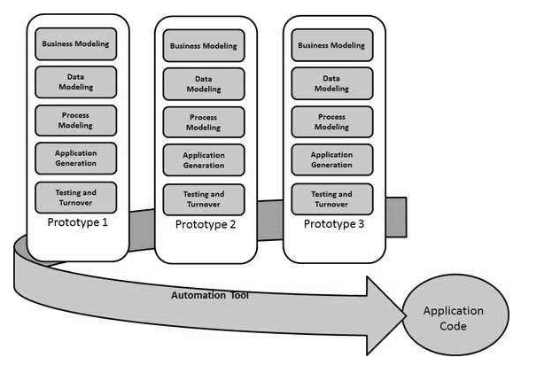
RAD MODEL

Slide 4
CORE ELEMENTS OF RAD
Business modeling
Data modeling
Process modeling
Application generation
Testing and turnover
RAD TOOLS(Erwin, CASE Tools, Rational rose,
Visio).

Slide 5
What mainly reduced by using RAD model?
Reduced Cycle time and improved productivity
How does customer involvement in the SDLC CYCLE help?
Customer is involved throughout the complete cycle minimizes risk of not achieving customer satisfaction and business needs.

Slide 6
Application of RAD model
RAD reasonably well known requirements.
User involved throughout the life cycle.
Project can be time boxed.
High performance not required.
Low technical risk.
Functionality delivered in increments.
System can be modularized and it can be broken down multiple non overlapping components.
It should be used if there is a high availability of designers for Modeling.
It should be used only if the budget permits use of automated code generating tools.
RAD SDLC model should be chosen only if domain experts are available with relevant business knowledge.
Should be used where the requirements change during the project and working prototypes are to be presented to customer in small iterations of 2-3 months.

Slide 7
PROS OF RAD MODEL
Progress can be measured.
Iteration time can be short with use of powerful RAD tools.
Productivity with fewer people in a short time.
Reduced development time.
Increases reusability of components.
Quick initial reviews occur.
Encourages customer feedback.
Integration from very beginning solves a lot of integration issues.

Slide 8
What is the risk associated with this model?
RAD requires sufficient human resources to create the right number of RAD team.
RAD is not appropriate where technical risk is high
What is the drawback of the customer being involved in the development cycle?
Developers ND Customers must be committed to rapid-fire activities in an abbreviated time frame.

Slide 9
CONS OF RAD MODEL
Dependency on technically strong team members for identifying business requirements.
Only system that can be modularized can be built using RAD.
Requires highly skilled developers/designers.
High dependency on Modelling skills.
Inapplicable to cheaper projects as cost of Modelling and automated code generation is very high.
Management complexity is more.
Suitable for systems that are component based and scalable.
Requires user involvement throughout the life cycle.
Suitable for project requiring shorter development times.

